Slide 1





Good
Afternoon!
Let’s Plan Our
Wonderful Hackathon!
Fredz
The what,
the why
and
the how
Micro frontends

Slide 2



Good
Afternoon!
Let’s Plan Our
Wonderful Hackathon
Fredz
The What,
The Why
And
The How
Micro frontends
July 2023
Vilnius, Lithuania
S | M | T | W | T | F | S
 |  |  |  |  |  | 1
2 | 3 | 4 | 5 | 6 | 7 | 8
9 | 10 | 11 | 12 | 14 | 15 | 16
17 | 18 | 19 | 20 | 21 | 22 | 23
24 | 25 | 26 | 27 | 28 | 29 | 30
°
23
Tuesday
26
9 AM
10 AM
11 AM
12 AM
Breakfast
16°
18°
20°
23°
08:00 -09:00
Gym
Phone Battery
10:00 -11:00
Meeting
12:00 -13:00
Lunch
75%
13:00 -14:00
Design Work
15:00 -16:00
Yoga
17:00 -18:00
Meditation
19:00 -20:00

Slide 3



Let's Do This!
Micro Frontends
Micro frontend is a front-end web development
pattern in which a single application may be built
from disparate builds. It is analogous to a microservices
approach but for client-side single-page applications written
in JavaScript. It is a solution to de-composition and routing
for multiple front-end applications.
Friday
17
What are they?
How Do They
Work?
Who Needs
Them?

Slide 4
Go Back
What Are Micro Frontends
Scalability
What benefits does it offer?
The idea behind Micro Frontends is to think
about a website or web app as
a composition of features which are owned
by independent teams. Each team has a
distinct area of business or mission it cares
about and specialises in.
A team is cross functional and develops
its features end-to-end, from database to
user interface.
Maintainability
Faster deployment
and troubleshooting
Easy upgrades
Independent
stack versions
Notes:
https://www.mindbowser.com/micro-frontends-and-steps-to-implement-micro-frontends/
Scalability
Micro-frontend development teams have an advantage because they can quickly start spinning up new teams when they need to deliver additional front end functionality. This allows you to scale your development process without disrupting other teams that are working on other parts of the application.
Maintainability
When front end repositories are kept small and specialized, it’s easier to understand them, and this makes it simpler to do long-term maintenance and testing. This ensures that features can be easily tested in isolation and that the overall testing time is reduced.
Faster deployment and troubleshooting
Embracing the micro-frontends architecture improves the development process. With this architecture, we can have smaller independent teams work on different features, and the deployment process becomes faster and with fewer errors.
Independent stack and versions
Autonomy allows each team to make choices about the technologies they use. For instance, a team could develop their micro-frontend using Vue.js, and the other team could develop their frontend using React.
This way, each team can concentrate on what works best for them without coordinating with or relying on other teams.
Easy upgrades
The development teams can easily upgrade the architecture without touching the old one. They even can be tested independently. The easy upgrades make it even easier to deploy faster.

Slide 5

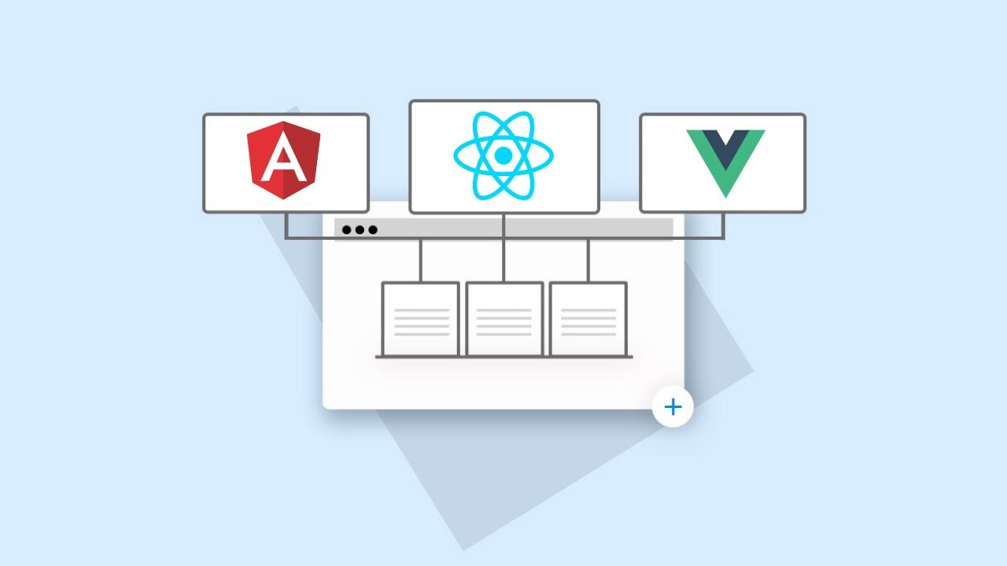
Go Back
How to implement
Micro Frontends
Build-Time Integration
The main key in Micro-Frontends is the integration
between the host/container and Micro-Frontends.
There are two ways to integrate Micro-Frontends
Run-Time integration
Notes:
https://levelup.gitconnected.com/micro-frontends-what-why-and-how-bf61f1f0a729
Build-Time integration
This is what most of the code implemented today. The container will install the components as libraries, similar to the libraries you install from npm. The issues with this approach are syncing different versions of libraries and build issues. Also, it is tough to use different technologies. Also, the size of the final package will be big because it contained all dependencies. Moreover, you have to deploy again for any changes in dependencies. Also, there is a tight coupling between the container and all Micro-Frontends.
Run-Time integration
Run-Time integration has three types of Compositions:
Server-Side Composition
In this case, all the functionality will be in the backend that decides which Micro-Frontend to load. The server will decide which URL to route the request to. This is a standard server-side composition. I have used simple reverse-proxy using Nginx to do this task. However, there are many other implementations.
Edge-Side Composition
In this approach, you make use of CDN (Ex: AWS CloudFront) and Lambda@Edge. The orchestration will happen on the CDN itself, instead of the Client-Side or Server-Side. More about this at https://youtu.be/fT-5RHTtFNg
Client-Side Composition
This is what I have explained in the previous articles. In this case, the container is built and deployed separately. Each Micro-Frontend can be exposed as a separate package that the container/host can fetch the needed Micro-Frontend. For more explanation of this approach, refer to the list of articles at the end of this article or here. In this case, the container and the Micro-Frontends are completely de-coupled. They do not share build or deployment and can use different technologies. The container can decide on the version of the Micro-Frontend to deploy.
One of the methods used recently is Webpack 5 Module Federation Plugin. Webpack 5 Module Federation Plugin has been trending very high and providing very successful results. If you need more details, you can follow my other videos and articles here:

Slide 6

Go Back
Who would use
Micro Frontends?
Well let's find out!
Jump into my git repo and deploy some
micro frontends using webpack.
https://www.npmjs.com/package/create-mf-app
https://github.com/IOM-FredZ/mf-example-app.git

